Slide 1
RETAIL SALES
ANALYTICS
Overview, Key Findings & Strategic Recommendations
Benard Ochieng; Clare Mwangi; Rita Wangila; Sharon Nyabuto | Retail Sales Analytics Project | 2025 | Source: Retail Sales Data

Slide 2




DATA PREPARATION
DATA CLEANING & PREPARATION
Before any analysis, the dataset was cleaned and structured to ensure accuracy and reliability.
Date Formatting
Transaction Validation
Converted the Date column to the correct format. Derived new fields: Month Name, Quarter, and Weekend Flag for time-based analysis.
Verified that Quantity × Price per Unit matched Total Amount for every record, ensuring calculation integrity.
Age Group Segmentation
Price Tier Classification
Classified customers into 5 bands: Young Adults (18–25), Millennials (26–35), Gen X (36–45), Boomers (46–55), Seniors (56–65).
Segmented products into Budget, Mid-Range, and Premium tiers to enable price-sensitivity analysis.
Source: Retail Sales Data

Slide 3
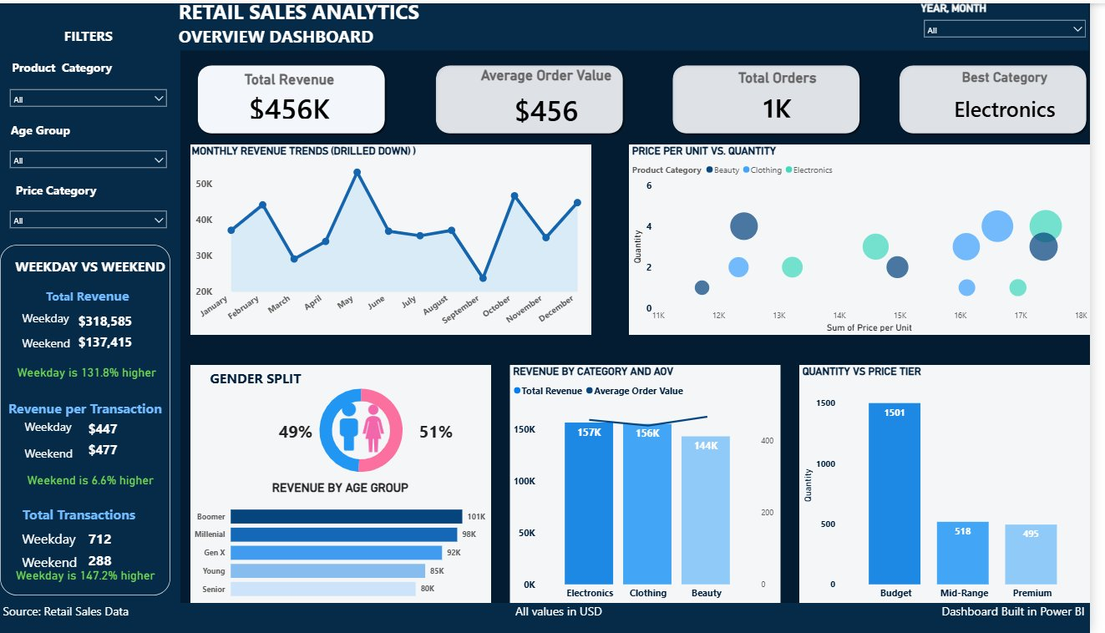
DASHBOARD OVERVIEW
POWER BI DASHBOARD
Full overview — all metrics reflect the complete dataset.
Dashboard Built in Power BI | Source: Retail Sales Data

Slide 4


KEY METRICS
HEADLINE NUMBERS
KEY PERFORMANCE INDICATORS
$456K
$456
1,000
Electronics
Total Revenue
Avg Order Value
Total Orders
Best Category
All categories combined
Per transaction
Across all channels
Highest AOV & revenue
Source: Retail Sales Data

Slide 5
BEST CATEGORY
BEST PERFORMING CATEGORY
Electronics Leads
$156,905 in total revenue — highest of all three categories.
Narrow Margin
Electronics beats Clothing by just over $1,000 — the gap is extremely tight.
AOV Advantage
Despite lower volume, Electronics earns more per sale; higher value per transaction.
All values in USD | Source: Retail Sales Data

Slide 6

CUSTOMER DEMOGRAPHICS
WHO IS THE CUSTOMER?
Gender split and age-group revenue reveal a broad but aging customer base.
Insight: Boomers drive the most revenue. Young Adults are the lowest-contributing segment; present an untapped opportunity for long-term growth.
Source: Retail Sales Data

Slide 7
WEEKDAY VS WEEKEND
WEEKDAY VS. WEEKEND BEHAVIOUR
Volume dominates on weekdays; weekends generate higher value per transaction.
$318,585
$318,585
Weekday Revenue
Weekday Revenue
131.8% higher than weekend
131.8% higher than weekend
712
288
Weekday Transactions
Weekend Transactions
147.2% more than weekend
$447
$477
Weekend AOV
Weekday AOV
6.6% higher than weekday
Strategy: Weekdays = More about volume. Weekends = more about value. Different promotional strategies may suit each.
Source: Retail Sales Data

Slide 8


REVENUE TRENDS
MONTHLY REVENUE TRENDS
Revenue peaks in May and dips sharply in Q3; a critical window for intervention.
May Peak
Q3 Dip
Source: Retail Sales Data

Slide 9
RECOMMENDATION
STRATEGIC RECOMMENDATION
Reinforce targeted marketing in Q3 to address the revenue dip.
Revenue remained below average through August and fell sharply in September(lowest month of the year) an indication of a consistent gap that requires a proactive response.
DATA PROOF
SUGGESTED ACTIONS
September recorded ~$23K — the single lowest month in the dataset.
The sharp decline followed by recovery in Q4 suggests that targeted intervention during Q3 could help stabilize overall yearly performance and prevent future dips.
Q3 recorded the lowest performance across all four quarters at 96,000, representing a 22.4% decline from Q2 and a weak performance, at 15.8% below the annual average.
The store could launch Q3 promotions 4–6 weeks ahead of September
Target Young Adults — underrepresented and high growth potential
Source: Retail Sales Data

Slide 10
SUMMARY
Three findings. One clear action.
01
Electronics leads — but narrowly
Electronics is the top revenue driver with the highest AOV, yet the margin over Clothing is razor thin at just over $1,000.
02
Boomers are the core customer
The customer base is broad and gender-balanced. Boomers contribute most; Young Adults remain an untapped growth opportunity.
03
Q3 is the critical risk window
September is the lowest revenue month. A proactive Q3 marketing push — especially targeting younger demographics — is the priority recommendation.
Retail Sales Analytics 2025

